Slide 1

Sir Syed University of Engineering & Technology
CS-128L Object Oriented Programming

Slide 2
PROJECT PLANNER

Slide 3
TEAM MEMBERS:-
S.NO | NAME | ROLL NO | EMAIL ADDRESS
1 | MUHAMMAD AREEB MUSANI (TEAM LEADER) | BCS-2020F-082 | CS20F-082@ssuet.edu.pk
2 | OWAIS IRFAN | BCS-2020F-080 | CS20F-080@ssuet.edu.pk
3 | SYED ABEER ALI | BCS-2020F-262 | CS20F-262@ssuet.edu.pk

Slide 4
INTRODUCTION:-
In this project, we make a c# application which named as “Project planner”.
In this application we make a system which help for your administrative plan projects in any educational environment . The purpose of this application is to make an online platform for teacher where
Record has been managed and making easiest way to assign the project
And publish reminder about deadline of the project and giving remarks
According to it
Making groups of student
Remove student
Add student
Marks and remarks

Slide 5
FEATURES OF PROJECT:-
In this application there are following feature which described below,
Add Batches
Add Users
Import student data from excel sheet batch wise
Create groups of students batch wise
Assign projects and maintain submissions
Display Reminders about projects due, submissions due
Upload remarks and marks accordingly
Search feature

Slide 6
METHODOLOGY:-
The Login Form of Pro Plan
Admin and the user can log in from the same form but a certain feature they disable for the user are only for the administrator.• Only an administrator can create other users and can check their details and update their data.• Only an administrator can delete a user ID from this application.

Slide 7
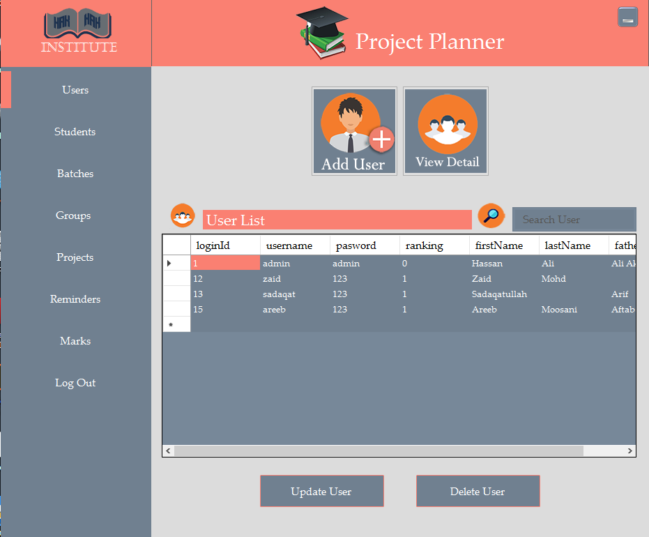

Slide 8
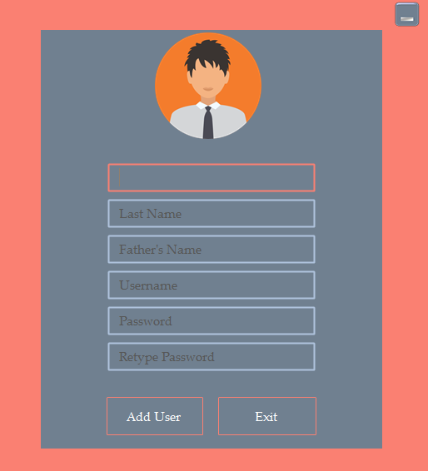
User Form
By clicking “New User” button a form appears on the screen in which detail about user like First Name, Last Name, Father Name and Age etc. can be fill in these field where username and password are require fields to be filled.

Slide 9
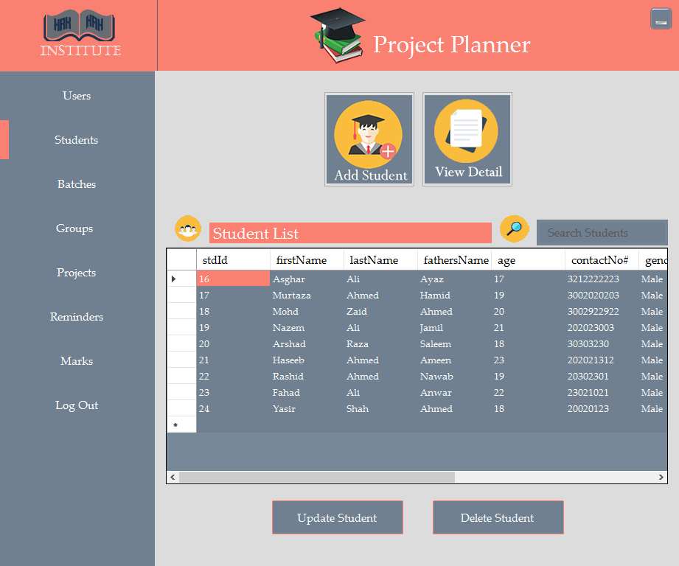
Student Section
This section is for both Admin and users Other users can access in this section.By clicking “Student Button“ admin or user can create new student and also can see detail about every student whom were created before Admin and users can edit and delete any student data .

Slide 10
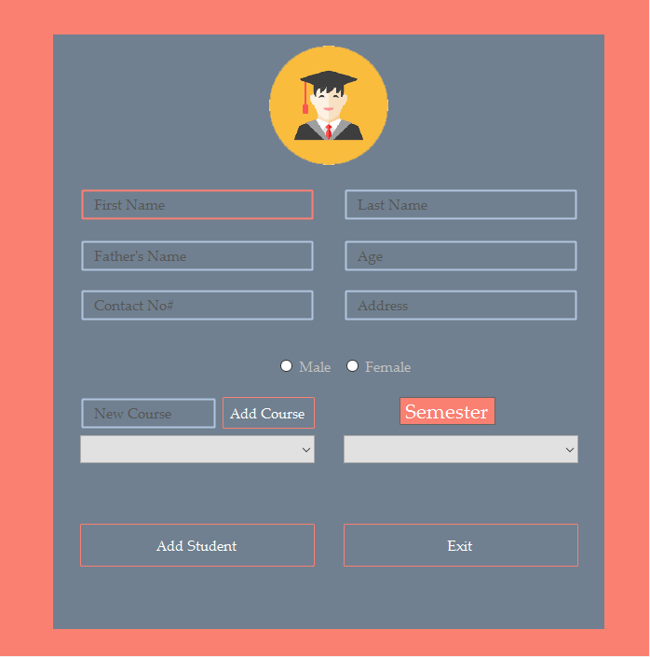
New Student Form To add a new student, this form is required to be filled by a user or administrator.
User can add new by entering name of course in Course text field and then pressing add course button.

Slide 11
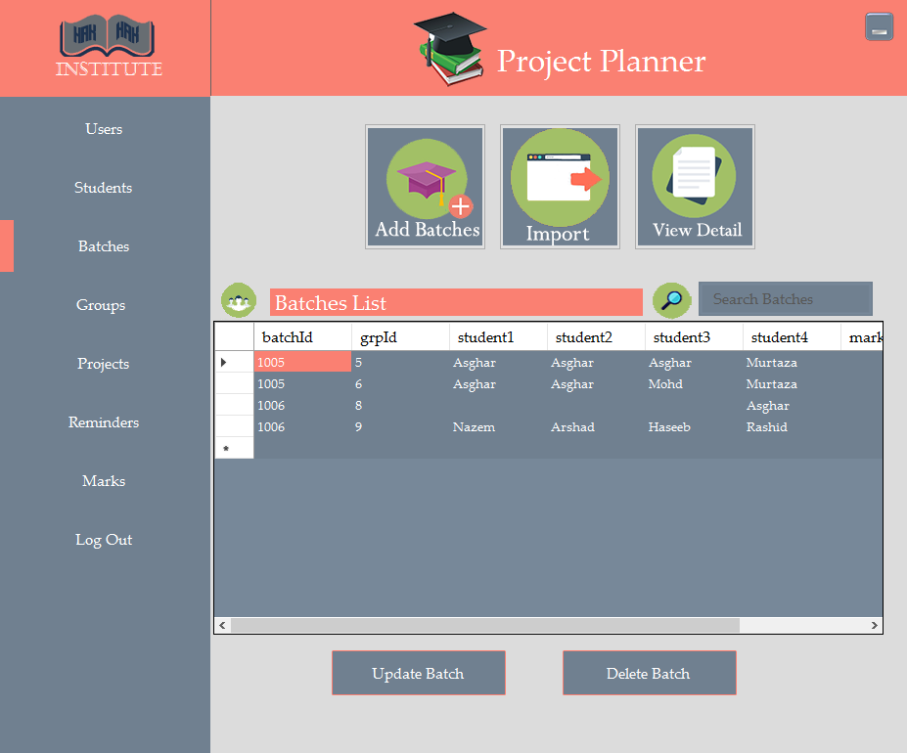
Batch Section
This section is also accessible for administrator and users By clicking “Batch Button“ admin or user can create new batches and also can see detail about every student whom were selected on the application. After add batch student can also be added in batches.

Slide 12
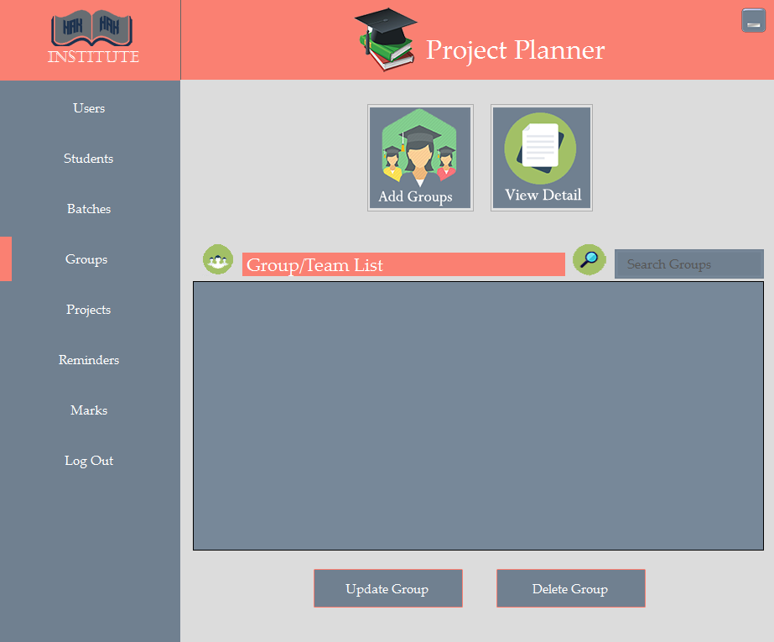
Groups of Students
User can add groups or team of four students for projects by clicking on the add group button as we can see in the picture below . Like students and batches user can search groups by typing group Id or student’s name in the search bar.

Slide 13
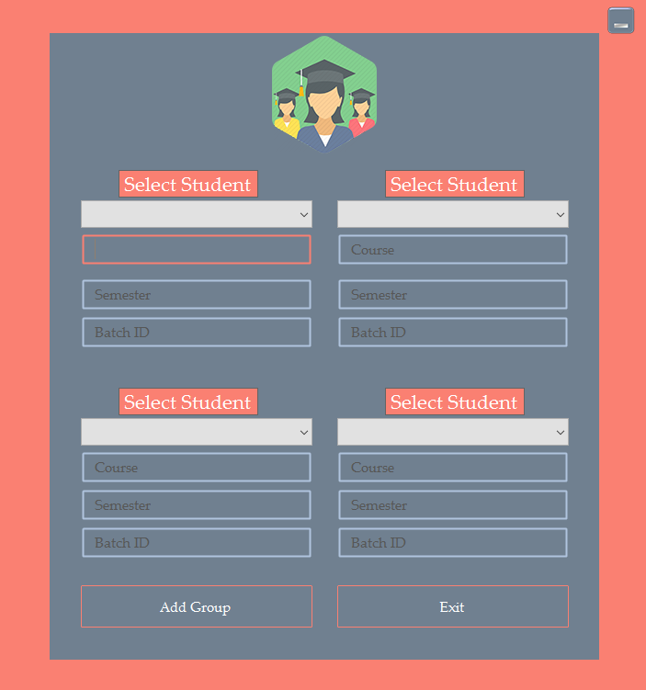
Adding Groups of Students
The user can choose four student name of the same batch by selecting the names in the combo box and add them into the group.by choosing his / her student’s name batch Id will also appear in the text field where the course and their semester are also listed.

Slide 14
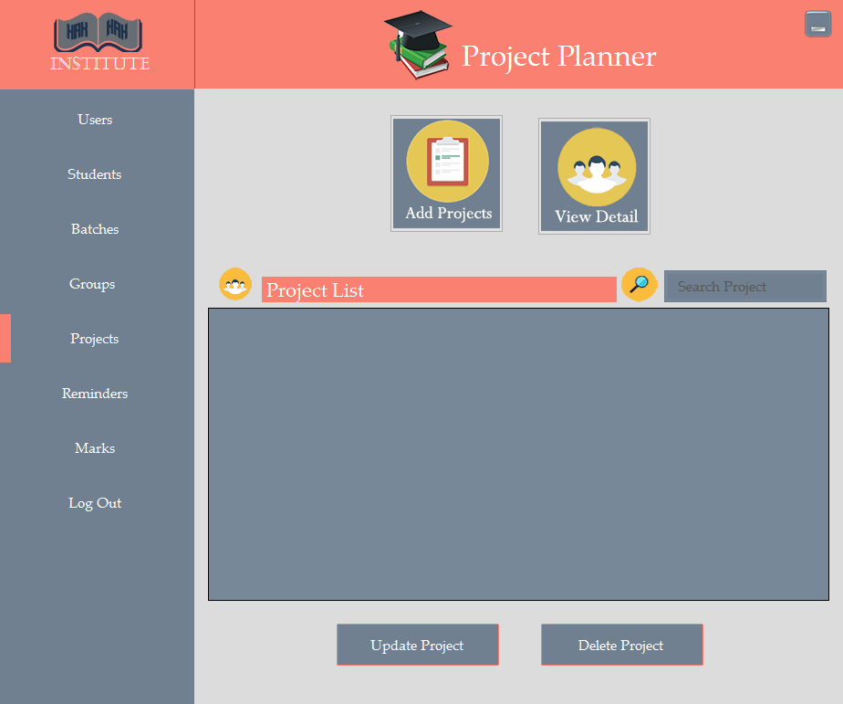
Projects:
After adding groups of four students, the user can assign them a project by clicking the Add Project button and can view the details by clicking the View button and can search for a project that has been given to other groups of students.

Slide 15
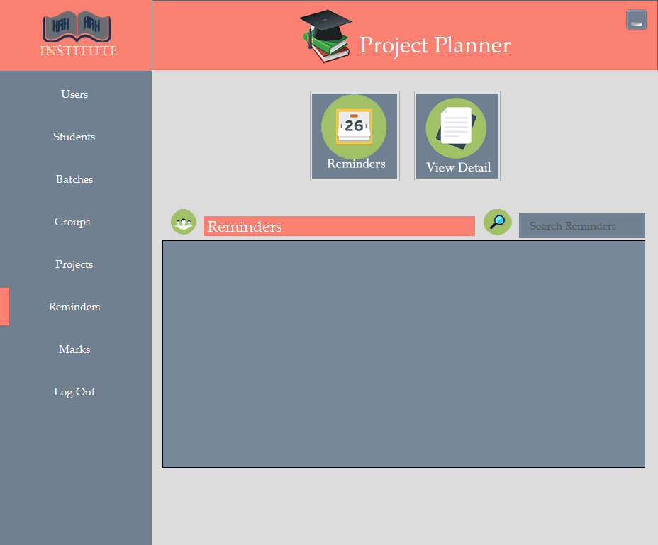
Reminder
The user administrator and user can add a reminder to the projects to remind them about the completion of the project by two days before

Slide 16
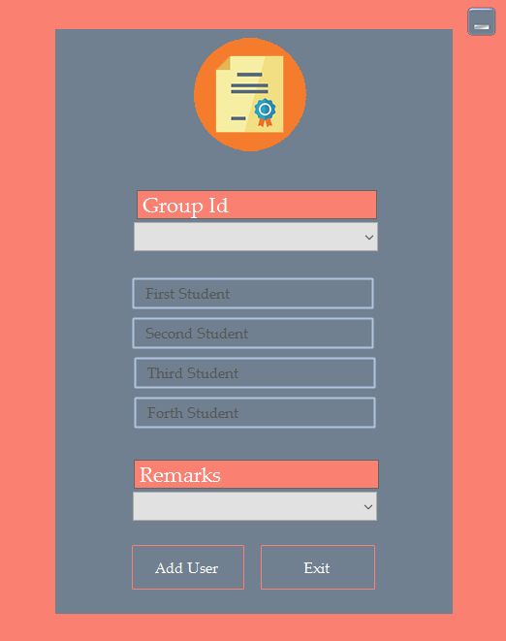
Marks & Rewards:
After submitting the projects a user or administrator can give marks to students and can also give comments by clicking the Add Marks button

